Slide 1

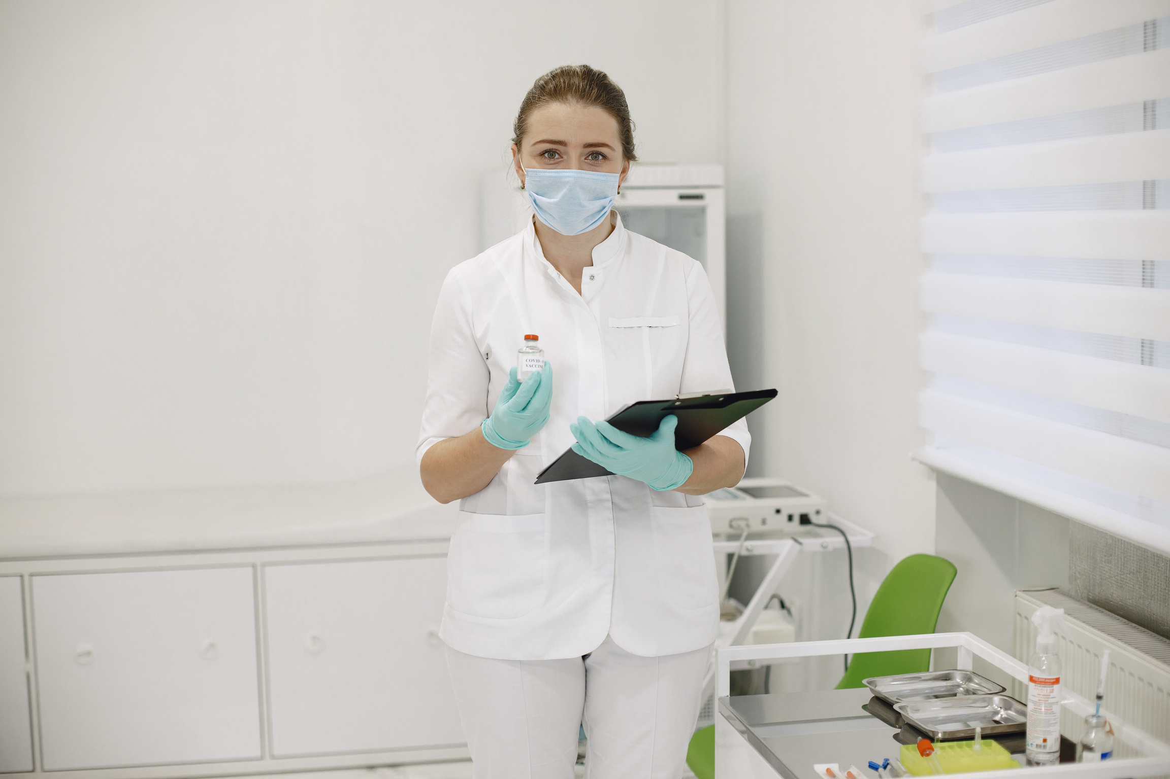

Team 8
Advanced Skin Disease Diagnosis

Slide 2
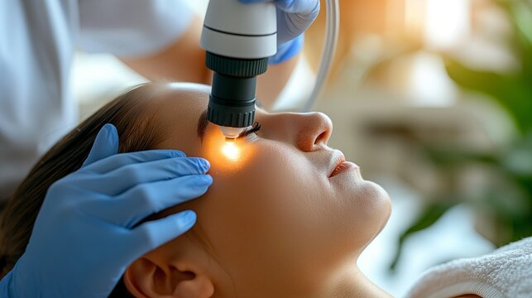



INTRODUCTION
Image-Based Diagnosis: The Advanced Skin Diagnosis System analyzes uploaded images of skin conditions to identify potential skin diseases.
Comprehensive Disease Detection: The system is capable of identifying a wide range of skin conditions, from common issues like acne to more complex dermatological diseases.
Specialization and areas of expertise , Instant Feedback: Users receive real-time results and recommendations based on the analysis, providing quick insights into potential skin concerns and facilitating early treatment.

Slide 3
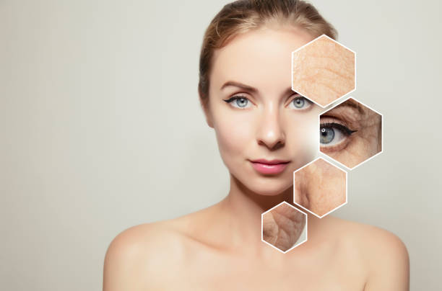
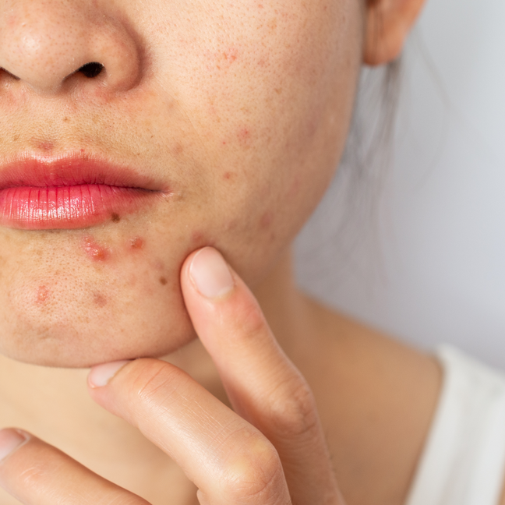
PROJECT OVERVIEW / CUSTOMER FEATURES
Create: Allows new users to register and set up their profile for accessing the skin diagnosis system.
Login: Provides secure access to the system for registered users to utilize diagnostic features.
Input Page: Enables users to upload an image of their skin condition for analysis.
View Page: Displays the diagnostic results and detailed information about the detected skin condition.

Slide 4
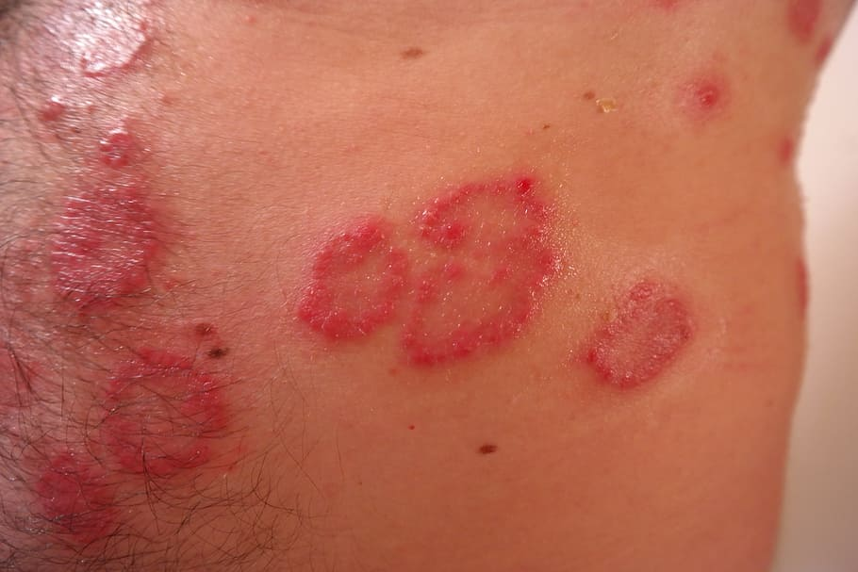
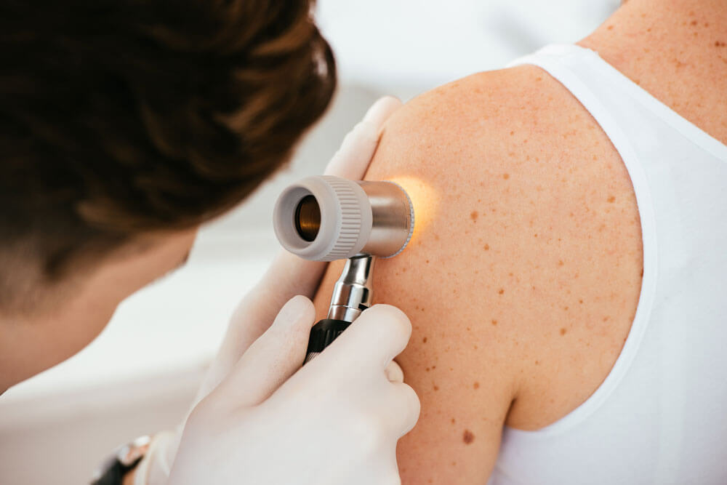
MILESTONES
Implemented an authentication feature in Django that includes home pauser login, sign-up, and profile management. The login and sign-up pages allow users to securely create and access their accounts. Once authenticated, users can access a personalized home and profile page.
OpenCV was utilized to process and analyze images of skin diseases, helping to identify specific patterns and features. This enables the accurate diagnosis of different skin conditions.

Slide 5
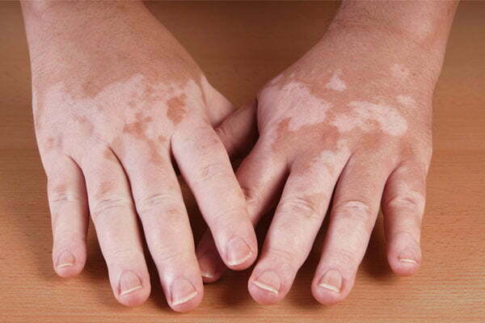
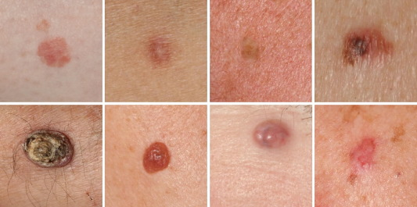
MILESTONES
Implementing the UI to read an image from user, process that image with opencv to calculate the dimensions of the skin disease area back to UI
Leveraged pre-trained data to build a disease detection model. Different models were analyzed to identify the most suitable one. The selected model is used to process uploaded images. It accurately identifies the detected disease.

Slide 6
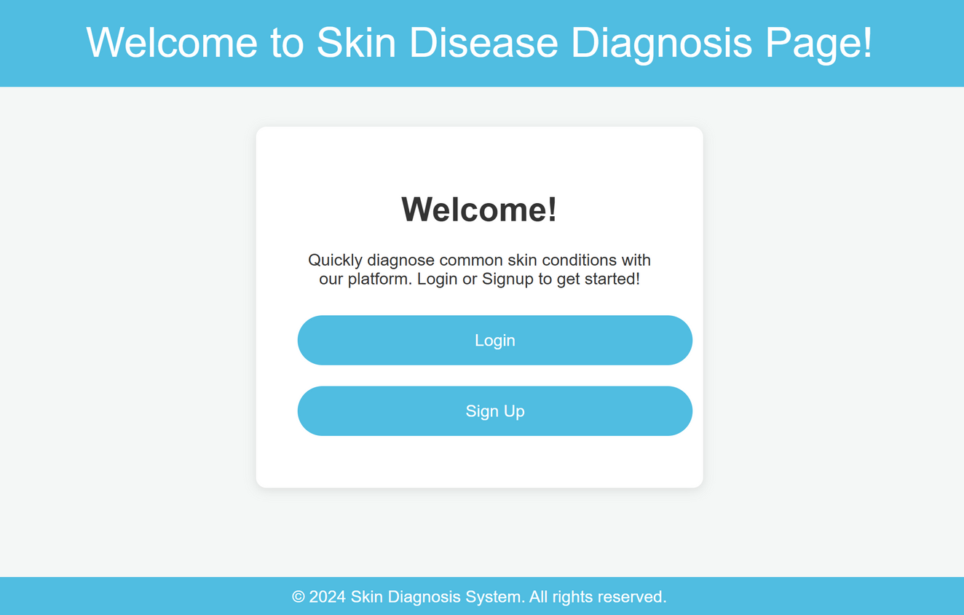
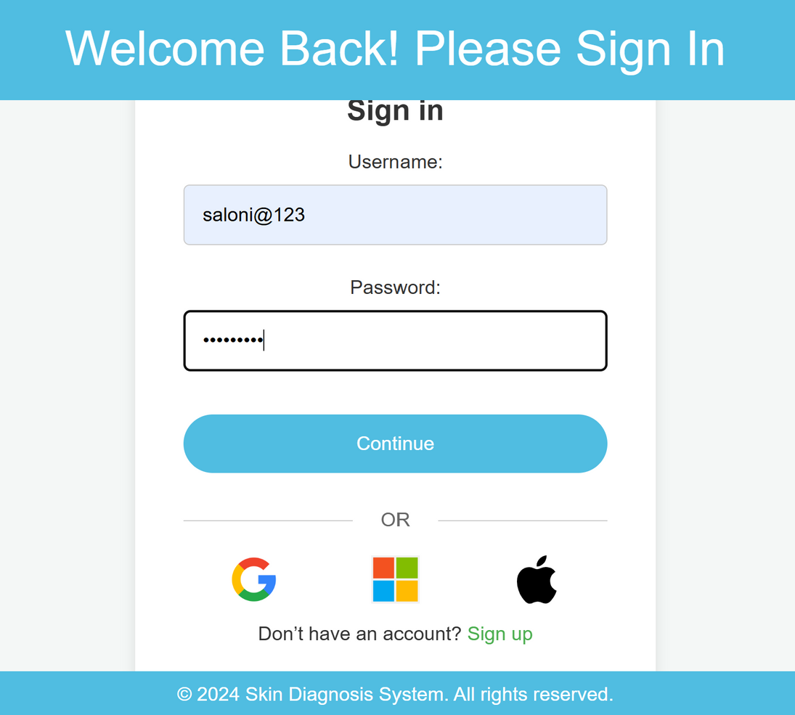



HOME PAGE/ LOGIN PAGE

Slide 7
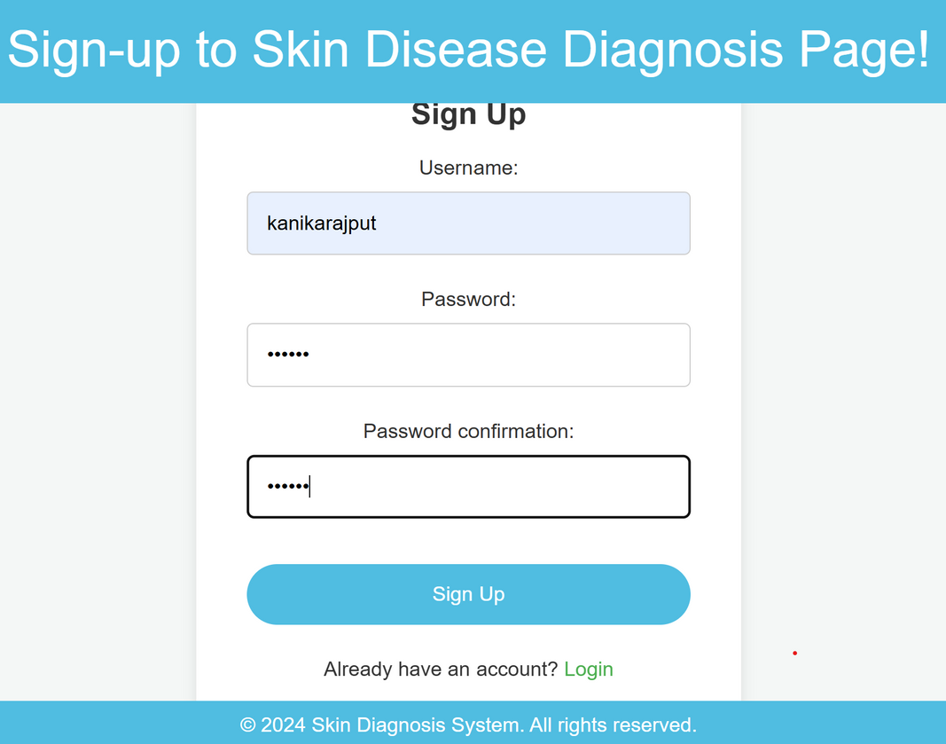
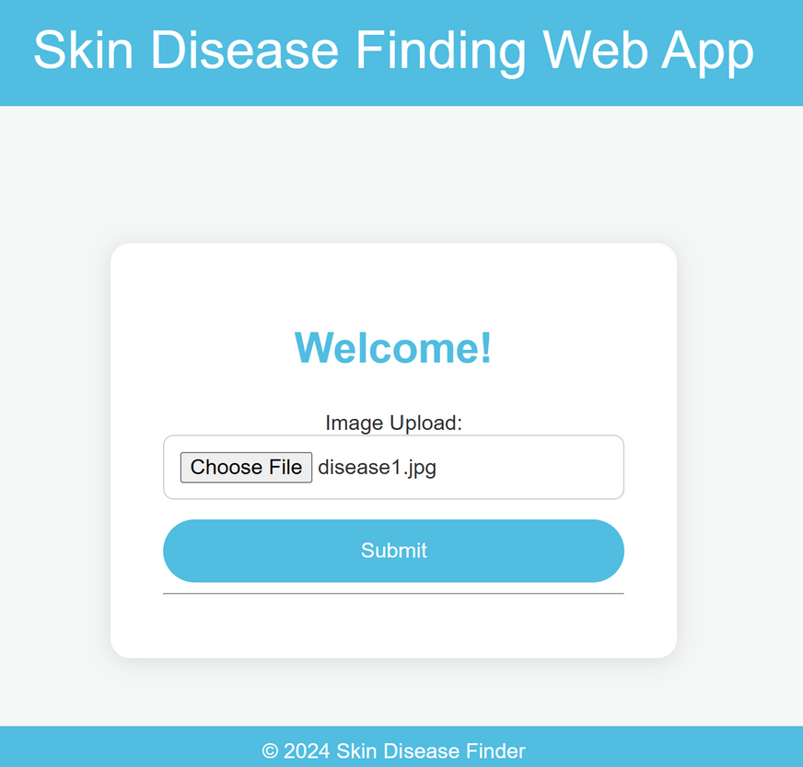

REGISTRATION PAGE / PROFILE PAGE
Avery Davis

Slide 8
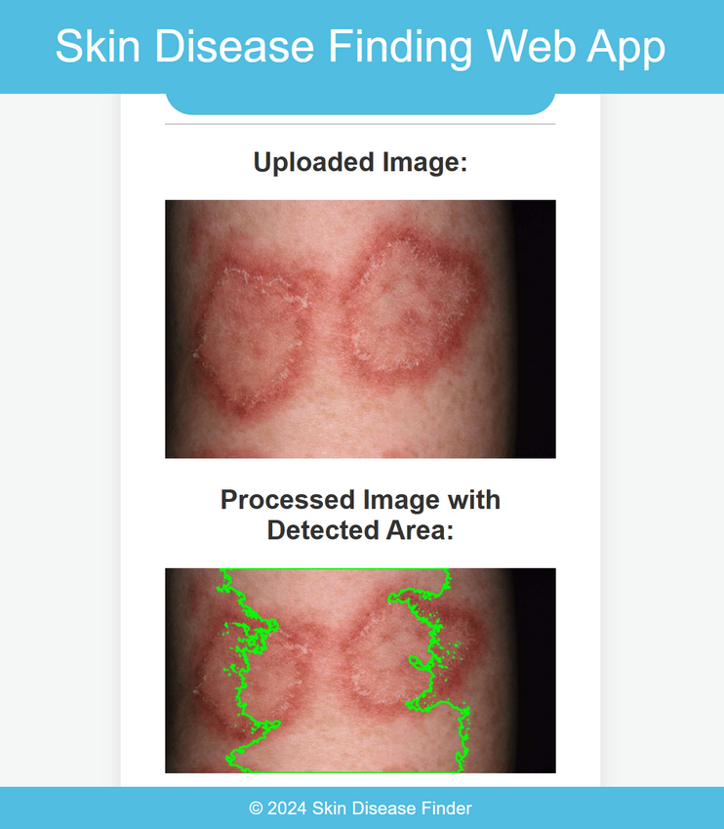
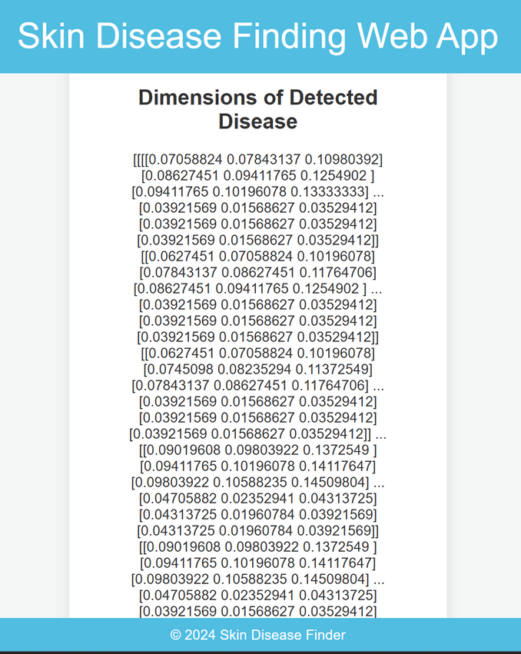
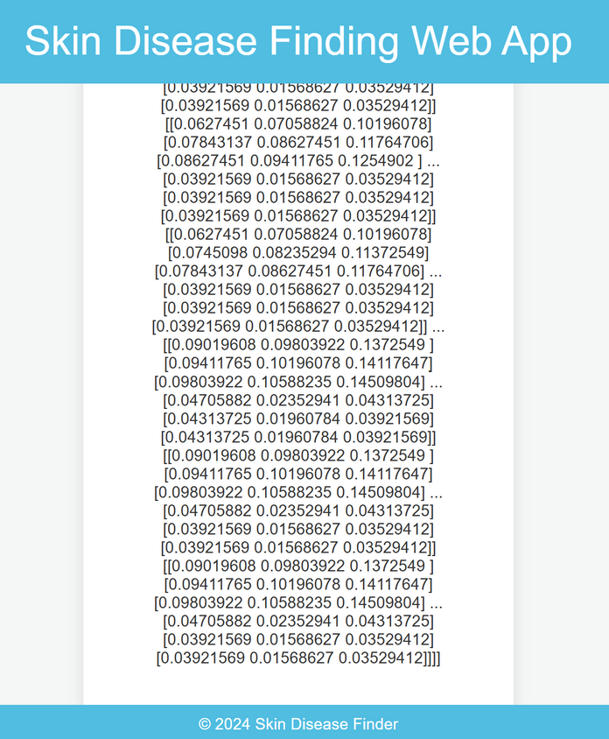
CALCULATED DIMENSIONS OF SKIN DISEASE

Slide 9
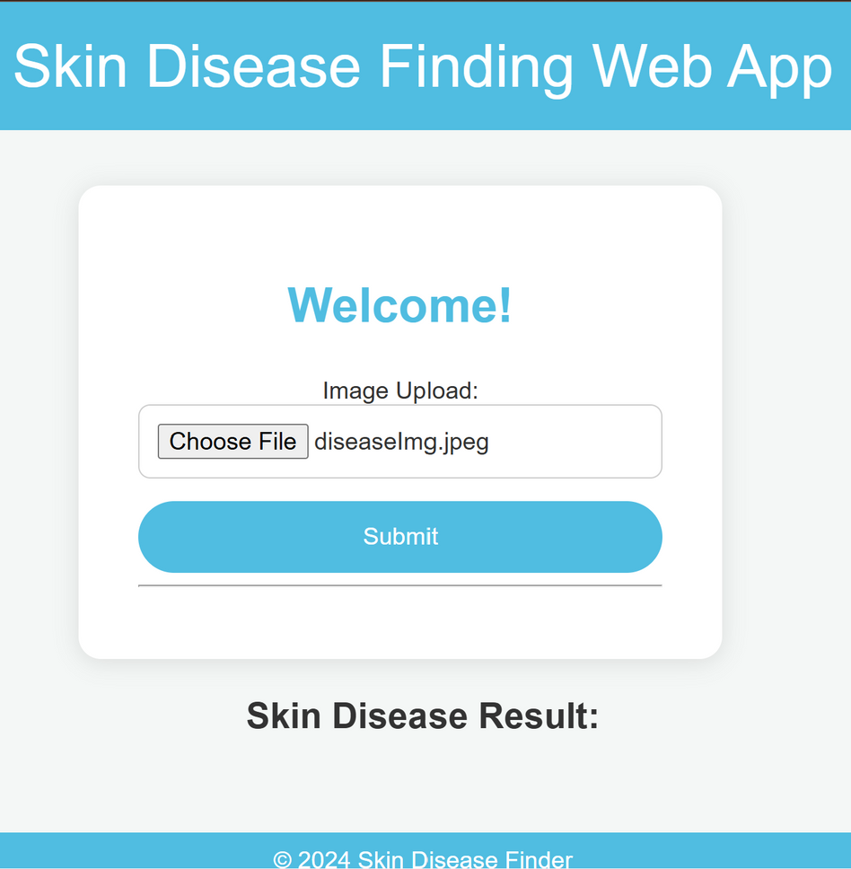
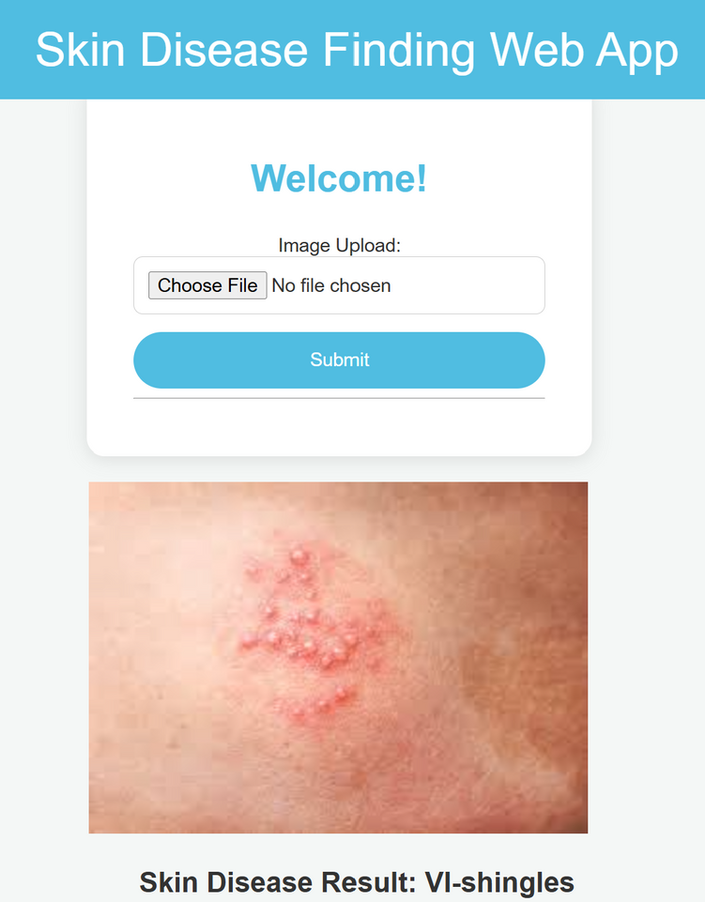
IMAGE UPLOAD / OUTPUT PAGE
Outpatient Services
Inpatient Services
Diagnostic Services

Slide 10

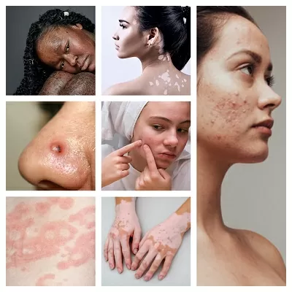
CONCLUSION
The "Advanced Skin Diagnosis leveraging image processing" system harnesses the power of OpenCV and Django (a python framework) to analyze and diagnose skin conditions from images. By accurately detecting key features and patterns in skin images, the system offers an efficient and reliable method for identifying various skin diseases. This innovative approach enhances early detection, enabling users to receive timely insights and recommendations for treatment.

Slide 11
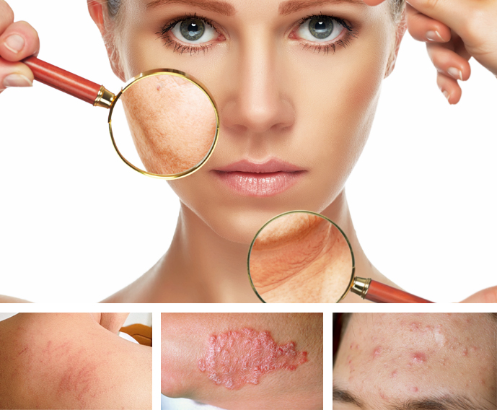
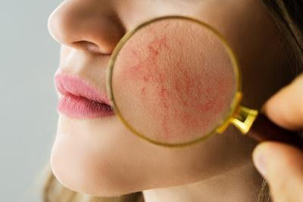
TEAM MEMBERS
Team 8:
Kanika Rajput
Sathi Lakshmi Narayana Reddy
Shaik Shariya

Slide 12
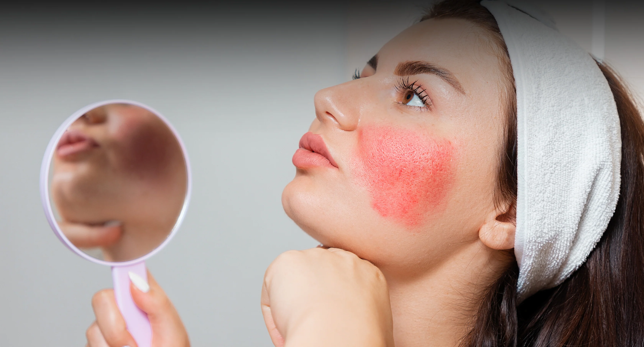
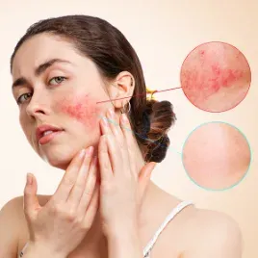
Thank
You

